Slide 1
Smart Travel Planner website
Done by sai chandu

Slide 2


Project overview:
The Product:
Smart Travel Planning Website is designed to simplify trip planning for travelers by offering intuitive features to organize itineraries, manage destinations, and explore activities. The platform allows users to create personalized travel plans
Project Duration:
3 weeks

Slide 3


Project overview
The Problem:
Ramesh is a traveler, he is getting confused with unfamiliar places. This confusion might leads to missing of several opportunities to experience unique places and many travelers is not aware of best time to visit places. This also haves the season specific recommendations
The Goal:
The Smart Travel Planning website aims to solve these issues by providing real-time, customized travel options and seamless integration of data in a single platform.

Slide 4


Project Overview:
My Role:
I am the product designer for this project, I am taking on multiple key roles, including Frontend Developer, Backend Developer, Database Administrator. This allows me to control every aspect of the project, from designing the user interface to managing server-side logic and ensuring seamless integration of external data sources.
Responsibilities:
Designing and implementing travel planning website, ensuring they optimized for performance across various devices

Slide 5
Understanding the user
User research
Personas
Problem statements
User journey maps

Slide 6

User Research: Summary
I conducted user studies to gain insights into how travelers approach trip planning and the challenges they face. The participants included a diverse range of travelers, from frequent flyers and business travelers to casual vacationers and budget-conscious adventurers. Through a combination of surveys and in-depth interviews, I gathered valuable data on their planning habits, the tools they use, and their pain points.
Many users expressed frustration with the overwhelming amount of information from various sources, making it difficult to consolidate and optimize their travel plans. Common pain points included a lack of real-time updates, difficulty in finding personalized recommendations, and challenges with route and cost optimization. Usability testing of existing travel planning tools further highlighted these frustrations, revealing gaps in features like seamless integration of transportation, accommodations, and activities.
These findings provided a clear understanding of user needs, guiding the development of a Smart Travel Planning website. By addressing these pain points, the platform will offer real-time updates, personalized itineraries, and a smoother, more efficient planning process.

Slide 7

User Research: Pain Points
1
Information Overload:
Users often struggle with the vast amount of travel information scattered across various platforms. They find it challenging to consolidate all this data into a cohesive plan, leading to confusion and inefficiency.
2
Difficulty in Real-Time Updates:
Users expressed frustration with the inability to receive real-time updates on important factors like season specific changes. making it harder for them to adjust their plans on the go. This lack of up-to-date information can lead to missed connections or unexpected delays during their trips.

Slide 8
Competitive analysis
Feature | Travelocity | Expedia | Travel | triplt | Smart Travel Planning Website
Competitive type | Direct | Direct | Indirect | indirect | Tailored travel planning, budget and preferences focused
Trip Planning Algorithm | Basic recommendation engine based on user search | Advanced booking algorithms | Driven non recommendation | Manual user input, itinerary creation | cost estimates for transport
Mobile App/ Website | app | app | no | app | website
Location Services | International destinations, based on user input | Global locations with country-specific offers | Global locations, driven suggestions | Limited to entered destinations | Personalized, budget-based, country/season-specific suggestions

Slide 9

Persona: Ramesh
Problem Statement:
Ramesh, a 35-year-old marketing executive, needs an efficient way to plan both work and family trips while managing a busy schedule, because he struggles to balance his work commitments and family vacations, often finding trip planning overwhelming and time-consuming.
Goals:
Discover best travel options based on the country and season.
Get optimized travel routes and recommendations for short work breaks.
Frustrations:
Uncertainty about choosing destinations that fit family preferences.
Overwhelm from manually searching for travel routes, destinations, and budgets.
Name: Ramesh.k
Age: 35
Profession: marketing executive
Company: San Brains, hyderabad
Qualification: bachelors
Hobbies: travelling, watching movies

Slide 10

Persona: Sita
Problem Statement
Sita, a 19-year-old freelance graphic designer, needs an easy way to plan budget-friendly trips that fit her flexible schedule, because she often finds it overwhelming to organize travel within her financial limits and struggles to manage her unpredictable freelance work hours.
Goals:
Get optimized travel routes and recommendations for short work breaks.
Discover best travel options based on budget, country, and season.
Frustrations:
Overwhelm from manually searching for travel routes, destinations, and budgets
uncertainty about choosing destinations that fit friends preferences.
Name: Sita
Age: 19
Profession: graphic designer
Company: microsoft, hyderabad
Qualification: bachelors
Hobbies: Travelling, reading books

Slide 11
User Journey Map
The Mapping of Ramesh’s user journey revealed how beneficial a smart travel planning website would be for users like him, who have a busy work schedule and limited time to organize trips.
ACTION | Browse Destinations | Compare Costs & Budgets | Select Travel Dates & Preferences | Finalize Itinerary
TASK LIST | A. Explore destinations online B. Filter by preferences Like number of travelling, travel date | A. Check cost estimations B. Adjust plans based on budget | A. Input travel dates B. Choose travel companions | A. Build complete itinerary with activities B. Review and finalize trip details
FEELING ADJECTIVE | Excited to find new places | Cautious about budget | Organized with trip details | Confident in the finalized plan
IMPROVEMENT OPPORTUNITIES | A. More personalized destination suggestions B. Better sorting and filtering options | Dynamic budget management tool | Easy calendar integration for travel dates | A checklist for travel essentials

Slide 12
Empathy Map
 | RAMESH (Marketing Executive, 35) | SITA (Graphic Designer, 19)
Says | "I need suggestions for places that aren't crowded." | "How can I make the most of my vacation?"
Thinks | "I want exciting new adventures and unique experiences." | "How can I find the best places to enjoy my time off?"
Does | Uses travel apps to explore new places and plan road trips. | Follows travel websites and social media for inspiration.
Feels | Excited about new places and ready for adventure. | Feels planning might be challenging without guidance.

Slide 13
Paper wireframes
Digital wireframes
Low-fidelity prototype
Usability studies
Starting the design

Slide 14
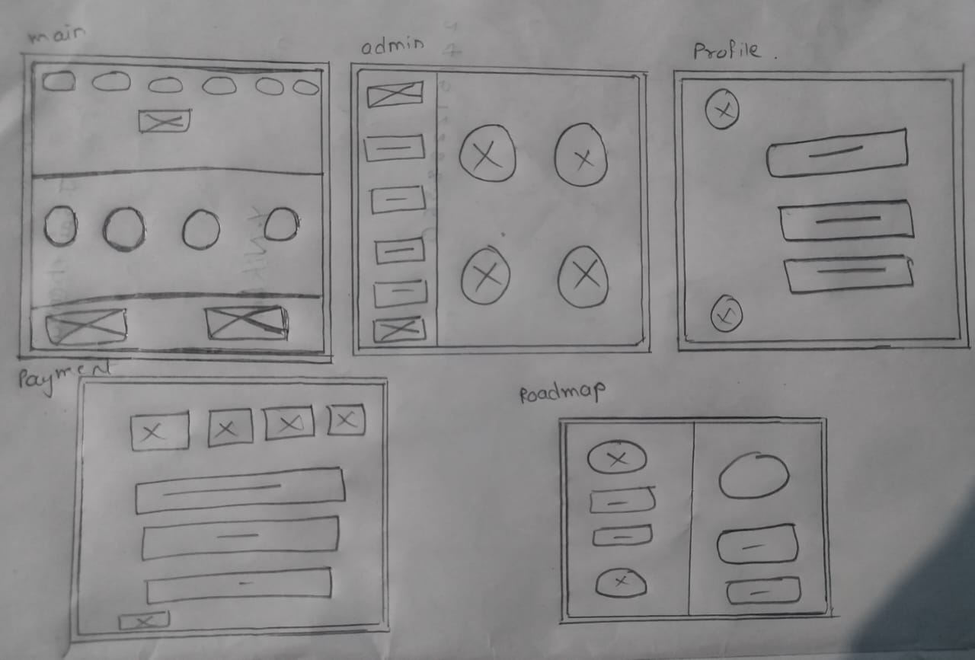
Paper Wireframes
01 to 05 paper iterations ensured that the elements incorporated into the Travel Planning platform were refined. For the dashboard, I preferred a simple and intuitive design to facilitate easy navigation for users.

Slide 15
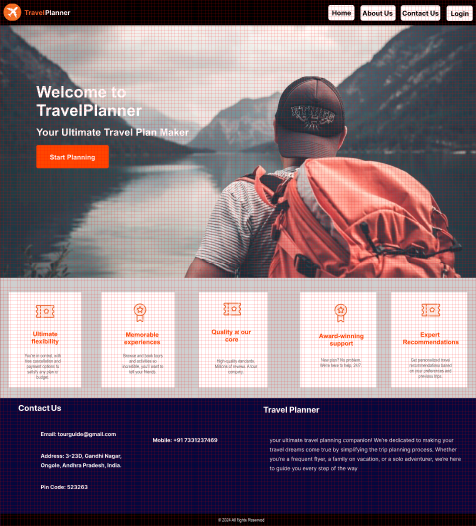
Digital Wireframes
As design development iterations continue, I made sure to the Home screen designs on findings from the user research.

Slide 16
Digital Wireframes
This is the digital wireframe of the admin dashboard. From this Admin can Access the Registered users, Listed Countries, Subscribed users. With this website admin can add, remove and edit the new designations.

Slide 17
Low-fidelity prototype
With the help of framework for digital wireframes, I created a low-fidelity prototype. The User flow I connected slides 01 to 08 , the simple interactions would help test the prototype in a usability study.
Link:
https://www.figma.com/proto/9X2UEL6K1MYbxdH3utucQr/Untitled?page-id=0%3A1&node-id=15-211&node-type=frame&t=MtNXqqRYU2ABhelR-0&scaling=min-zoom&content-scaling=fixed

Slide 18
Usability study: findings
The travelers were very diverse in their demands which made making a contained solution difficult. Some travelers had difficulty in finding the perfect travel plans, While some others lacking the perfect knowledge about the destination. Our website will give perfect plan with clear knowledge to travelers.
Round 1 findings
Round 2 findings
Users preferred quick and simple travel planning tools
Users took time to familiarize themselves with the interface
Users wanted a more intuitive flow for trip customization
Users wanted more tailored recommendations

Slide 19
Refining the design
Mockups
High-fidelity prototype
Accessibility

Slide 20
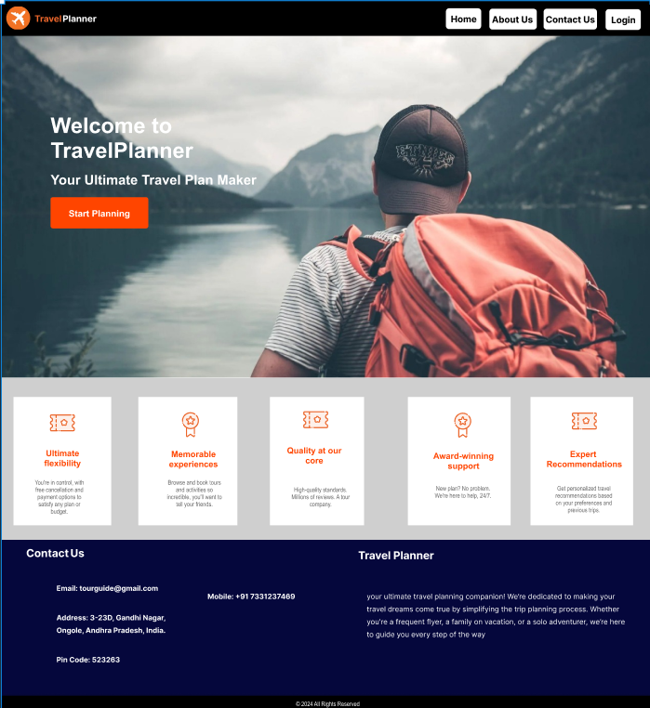
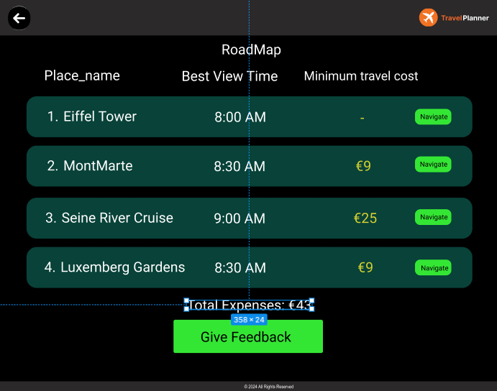
Mockups:
Main Page
I also revised the design colors, removed the arrow icons, and effectively tried to utilize white space for better user experience in global skill exchange.
Final Page

Slide 21
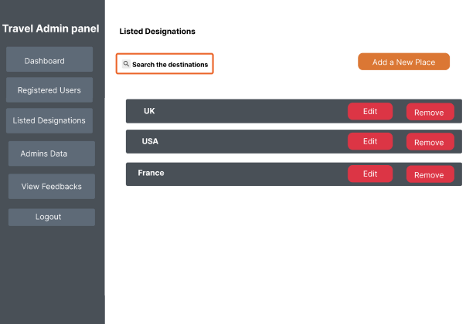
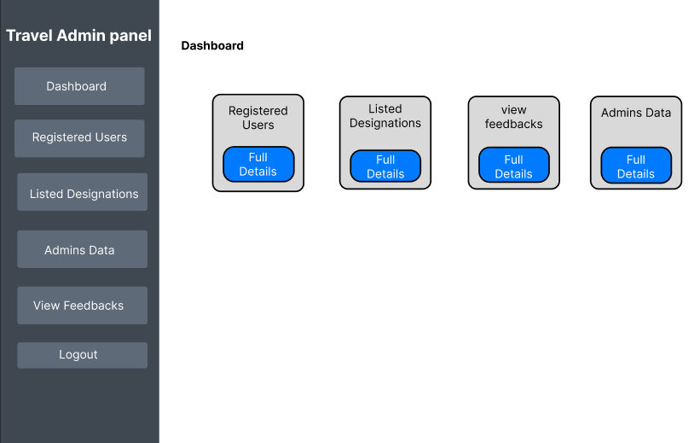
Mockups
Admin Dashboard
Listed Countries

Slide 22
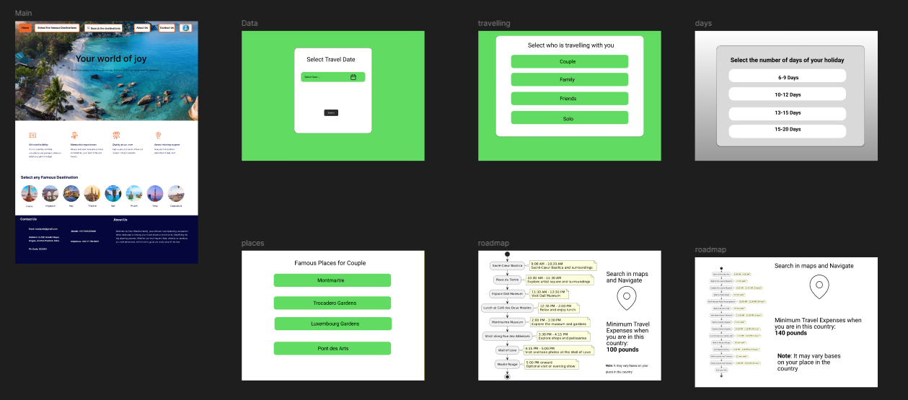
High-fidelity prototype
https://www.figma.com/proto/ONBN3zGkz7EHZWgE6cgiJL/Untitled?node-id=6-3&node-type=canvas&t=lrGtKkhl7ylKHpja-0&scaling=min-zoom&content-scaling=fixed&page-id=0%3A1&starting-point-node-id=6%3A3

Slide 23
Responsive design
Main Page
Admin Main Page
This is the responsive website design for Smart Travel Planning Website. In this 1st image was the main page in the website, whereas 2nd & 3rd are Admin Related Pages.

Slide 24
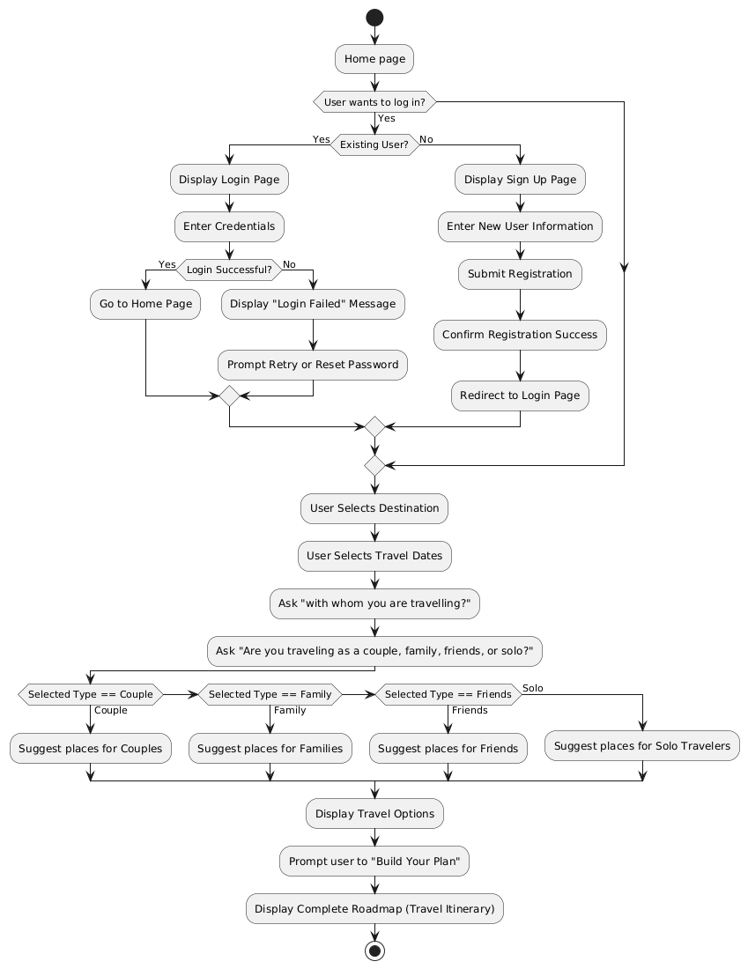
User Flow Diagram:

Slide 25
Accessibility Considerations
2
3
1
Using Gestalt Principles and adhering to WCAG color guidelines improved accessibility for all users, including those with visual impairments by creating clear and intuitive interfaces for selecting destinations, travel dates, and group preferences.
Incorporating larger icons arranged in a simple, consistent order with warm, contrasting colors enhanced the visual design for users, making it easier to the travel planning website
Utilizing color indicators within large icons helped improve visual memory, while offering a hands-free experience, ensuring accessibility for users with visual impairments.

Slide 26
Going forward
Takeaways
Next steps

Slide 27
Takeaways
What I learned: Through this project, I learned that flexibility and personalization are key to a successful travel planning experience. Offering features like selecting the type of travel group (family, couple, solo, friends) and allowing users to choose specific travel dates significantly improves the planning process. It enables users to visualize trips more clearly and plan according to their unique needs and preferences. Additionally, I realized the importance of making the travel planning interface intuitive and accessible, ensuring that users can easily experiment with different travel scenarios and organize their trips with minimal effort. This enhances user engagement and builds a stronger connection between the platform and its users.
Impact:
Implementing features that allow users to select the number of travelers, such as family, couples, solo travelers, or friends, and offering the option to choose travel dates will create a more personalized and best travel experience. By providing these customizable options, the platform can accommodate different user needs, making the travel planning process more efficient and enjoyable. This approach encourages users to explore travel scenarios based on their group type and travel dates, leading to better decision-making. Furthermore, offering a user-friendly planning interface enhances customer satisfaction, engagement, and loyalty, positioning the platform as a go-to travel planning resource for a diverse range of travelers.

Slide 28



Next steps
1
conduct thorough user testing for a diverse set of users, including families, solo travelers, couples, and friends. This will help identify areas for improvement, ensure the platform meets user expectations, and highlight any usability issues that need refinement.
Conduct another round of competitive analysis to know the competitive products in the market, as this segment is less explored and has a big future market.
Conduct post launch usability study to highlight new pain points of users and address them again .

Slide 29
Thank you

